Slide 1
SQL STUFF
Handy tricks for SQL development

Slide 2
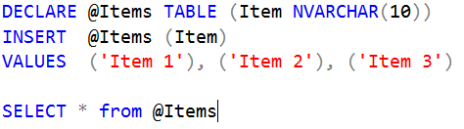
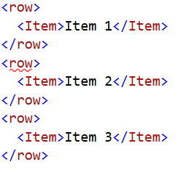
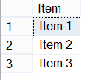
CSV List with XML PATH and STUFF
Using ‘For Xml Path’ converts a query to an Xml formatted string:

Slide 3
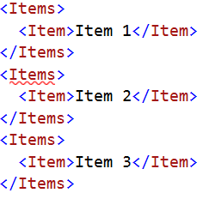
CSV List with XML PATH and STUFF
The ‘row’ node name can be specified as a parameter:

Slide 4


CSV List with XML PATH and STUFF
Or… remove the ‘row’ node completely:
If the column is unnamed, the element tags will be omitted:

Slide 5



CSV List with XML PATH and STUFF
We can take advantage of this to create a comma separated list:
Now we can use the STUFF function to remove the extra separator at the beginning and return as a string:

Slide 6
Using Non-Deterministic Functions in a User-Defined Function
SQL will not allow the use of a non-deterministic function within a user-defined function.
Attempting to create a function to generate a random Social Security Number string using the RAND function in the following example will create an error:

Slide 7
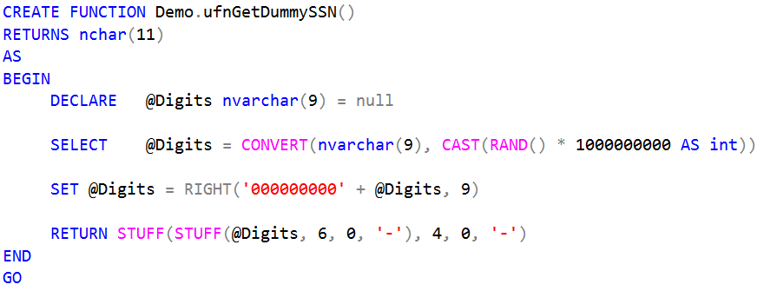
Using Non-Deterministic Functions in a User-Defined Function

Slide 8
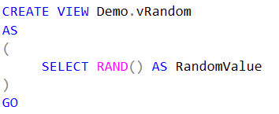
Using Non-Deterministic Functions in a User-Defined Function
SQL will, however, allow us to put a non-deterministic function in a view:

Slide 9
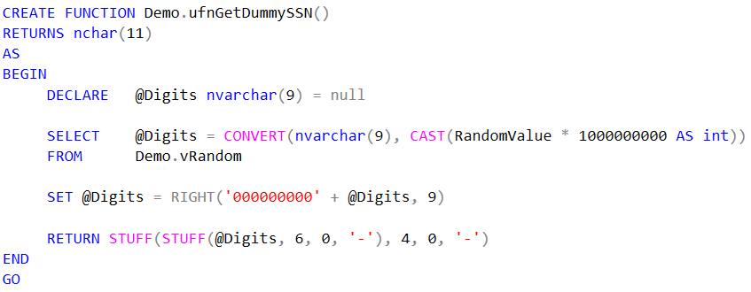
Using Non-Deterministic Functions in a User-Defined Function
Once we have a view with the function in it, we can select from that view within a user-defined function without raising an error:

Slide 10

Using Non-Deterministic Functions in a User-Defined Function
We can then successfully use our user-defined function to generate a random Social Security Number string:

Slide 11


